Slide 1
Web Tech 2 Project
Online Flight Booking
PES University
Md Faizan Siddiqui PES1201701740
Saqlain Pasha PES1201701539
Nikunj Goyal PES1201700020

Slide 2
Technologies Used
-CSS,Javascript,PHP
Database Used
-Sqlite3
Framework Used
-Flask (for backend)
What was implemented
Ajax Patterns, RSS Feeds, COMET Technique

Slide 3
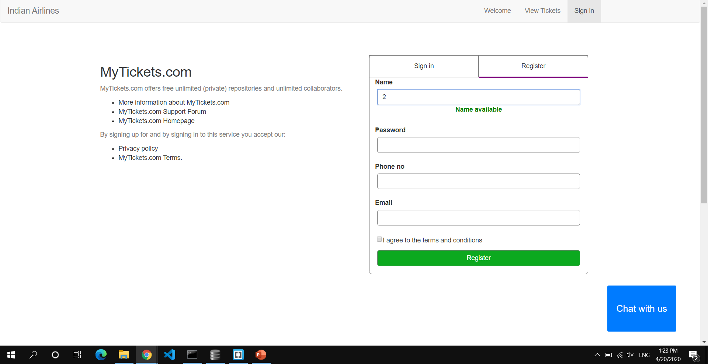
Components of the Website
Registration and Login Page:
-Uses a hidden frame for registration.
-Implements Submission Throttling to confirm if a name or number is available.

Slide 4
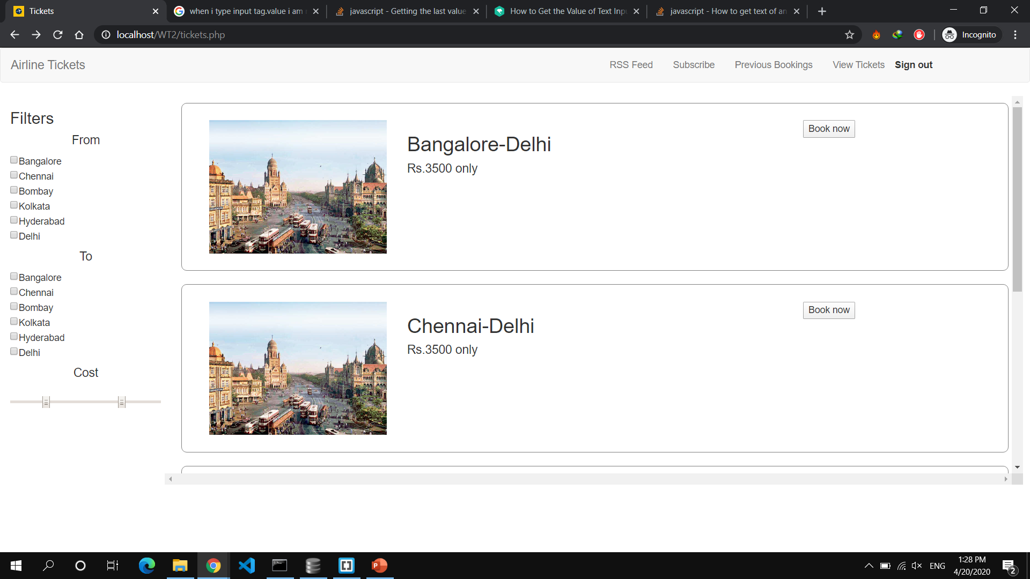
Tickets Page
-Uses multistage downloading to load the components of the page.
-Static CSS and JS files are sent separately
-Also implements Long Polling to keep track of dynamic pricing of the tickets.

Slide 5
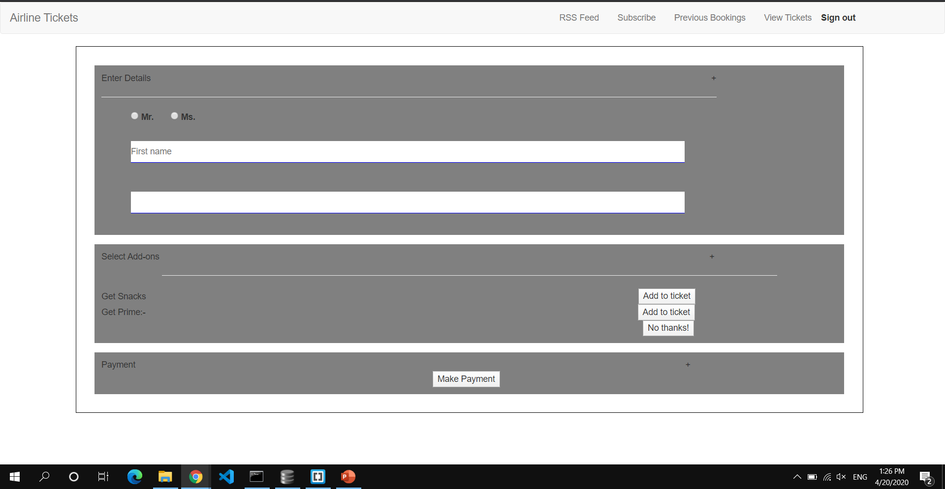
Booking
-Implements Predictive Fetch
-Static JS and CSS files are sent separately
Intelligent Component
-Chatbot.

Slide 6
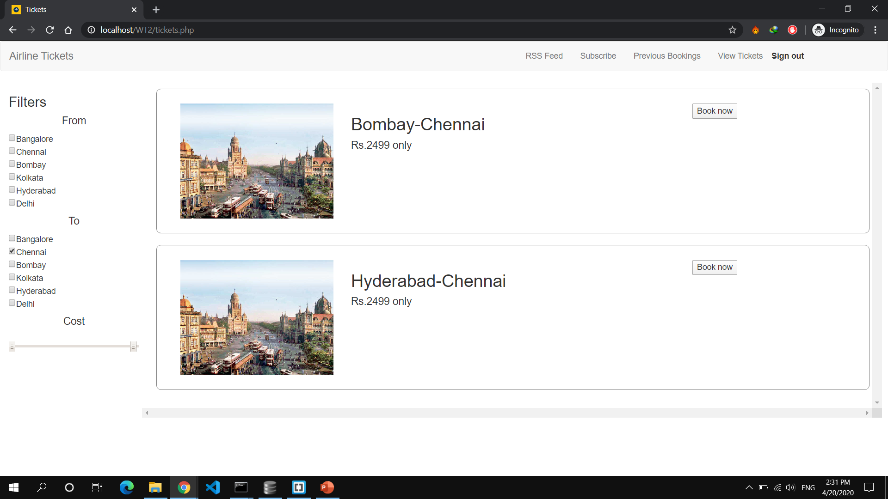
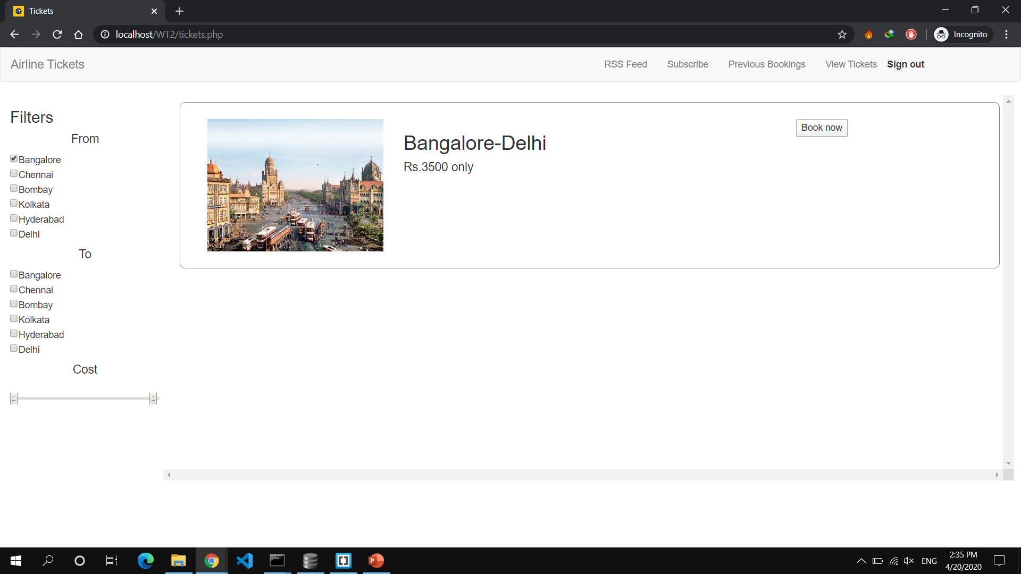
Filtering of flights

Slide 7
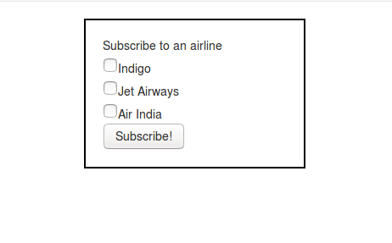
Subscribe
-Subscribe to an RSS feed of your choice.
-Can be modified.

Slide 8
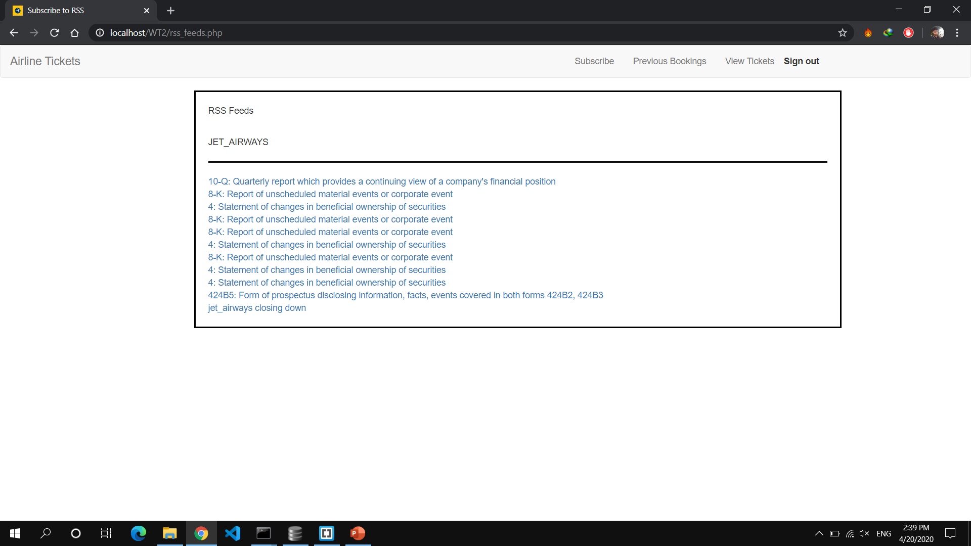
RSS Feed
-Shows the RSS feed.
-The RSS Feed is dynamically updated as soon as there is a change.

Slide 9
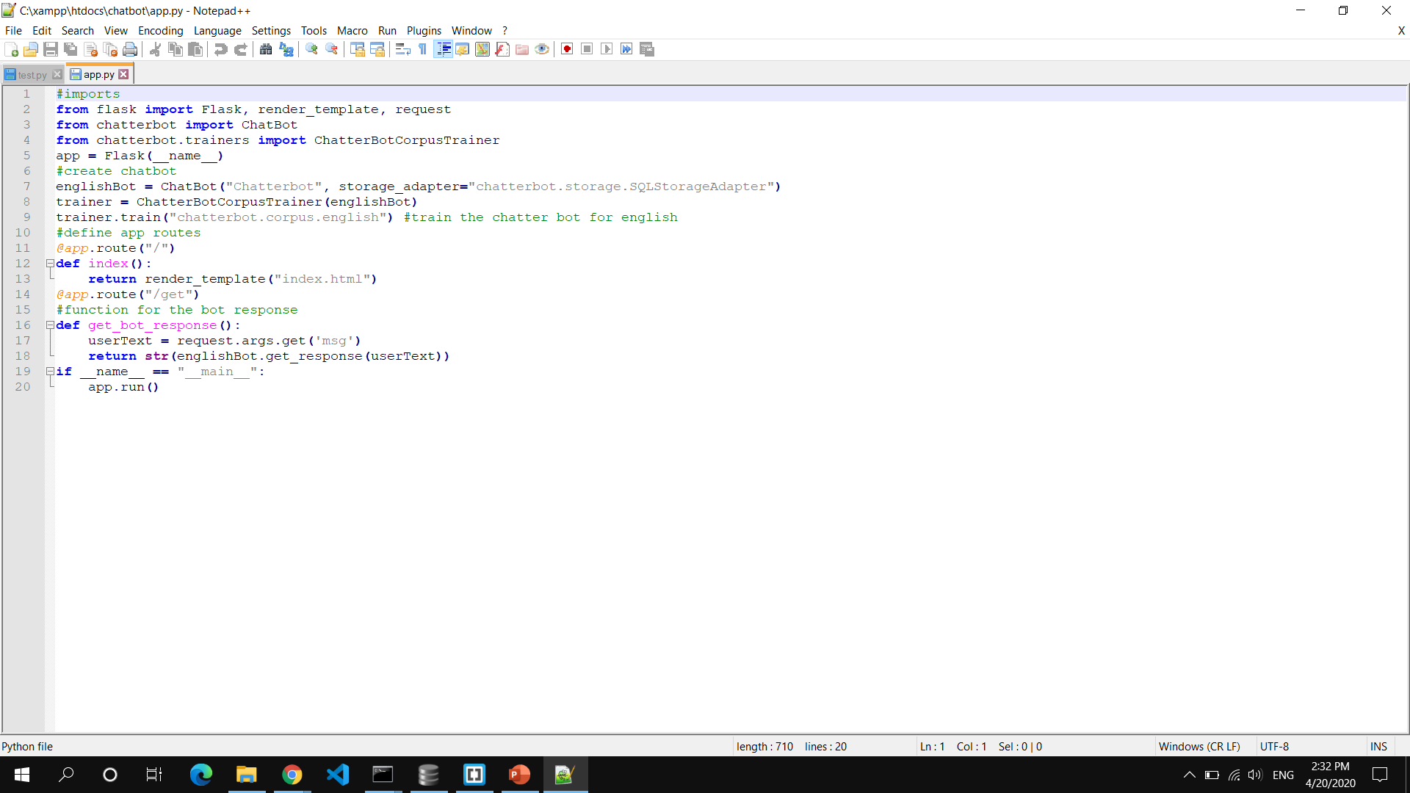
Chatbot

Slide 10
Thank You

